Slide 1
EADAS
Abhimanyu Chopra – G00885635 Lalitha baskharuni – G00949261 Nisarg patel – G00944795 Sammy lin – G00429253

Slide 2
Problem statement
In person monitoring of the elderly is not always convenient.
Solution : EADAS – Elderly Asset Distress Alarm System
Monitors
Orientation & acceleration to detect fall
Heart rate to detect spike or fall
Location, in case the elderly doesn’t respond
Alert
Sends status/location and time as sms to a set mobile number

Slide 3
Hardware block diagram
MSP-430EXPFR6989
Pulse Sensor
LCD
Gyro
LSM9DS0
Adafruit fona
GSM/GPS Module
4*3 matrix
Keypad
GSM Power Supply
Power Supply
Key:
Input
Output
Power
Logic

Slide 4
Software flow diagram Initialization Sequence
Initialize Clock
Initialize SPI
Initialize UART
Initialize Timer
Initialize ADC
Initialize LCD
Initialize Gyro
Start
Request Phone Number
Initialize FONA

Slide 5
Software flow diagram Application
Read Gyro
Get GPS Coordinates & Time
Read Heart Rate
Print to LCD
DISTRESS?
Send SMS
No
Yes

Slide 6
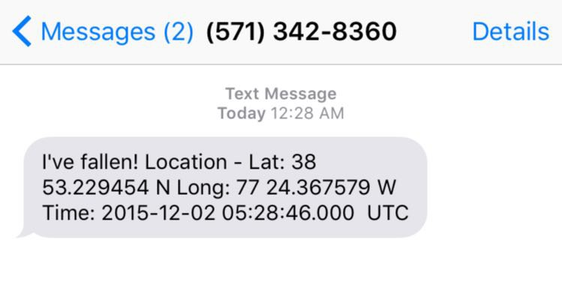
Sms Alert Example

Slide 7
Software tools
Code Composer Studio v6.1 – IDE for TI microcontrollers
Git – Source code management
Kicad – Schematic design
SketchUp – 3D design
Open source frameworks & components
Arduino C++ Libraries ported to Ti Launchpad in C (Gyro)
Implementation approach – pulsesensor.com (Pulse sensor)

Slide 8
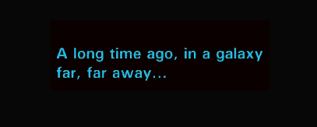
Project timeline

Slide 9
Project timeline
LCD code working
UART comm working/keypad working/PCB cut/complete assembly
Pulse sensor working
Gyro working
Started code
Distributed tasks amongst team
Complete documentation & 3D printing
Hardware received and distributed
Hardware researched/sourced
EADAS is born!
Complete pulse/SMS code
Formed team
Demo!
12/1/2015
12/8/2015
09/08/2015
11/24/2015
09/15/2015
09/22/2015
09/29/2015
10/06/2015
10/13/2015
10/20/2015
10/27/2015
11/03/2015
11/10/2015
09/01/2015
11/17/2015

Slide 10
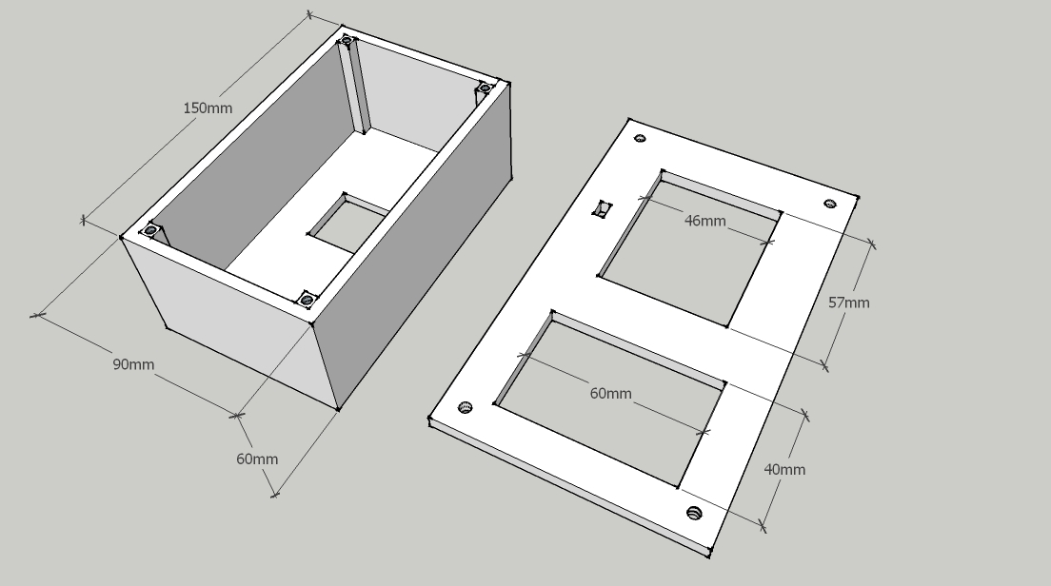
EADAS Case Design

Slide 11
Issues/solution
SPI interface – Hard to initially understand and get configuration right on Launchpad
Timing issues – printf to CCS console caused timing issues and UART/Timer/ADC stopped working as expected
Pulse Sensor – A very finicky sensor. Took a lot of time to troubleshoot errors
Integration – Required lots of testing and code changes
Most components purchased from Sparkfun/Adafruit come with Arduino libraries. Took full advantage and ported to MSP430 C/C++
ISRs – They had to be really fast
Didn't include buzzard in PCB design
3D Printing – Takes a lot of time

Slide 12
Demo Time!

Slide 13

Questions?

Slide 14

Motd

